Slide 1

project title
maybe a project subtitle? and your name!

Slide 2

Overview:
Our mission, that we’ve chosen to accept, is to:
-Analyse data from the movie industry
-Explore what goes into making a successful movie
-Provide actionable insights

Slide 3
Question 1:
How has the Popularity of Different Genres Changed Over Time?

Slide 4
Data Source:
TMDB -The Movie DataBase
-For reliable vote scores: removed all films with fewer than 5 votes
-Looking at films 2010-2019
-This left almost 13k films
Engineered Features:
Used the TMDB data to create aggregates for time-series data with a
6-month rolling window
Notes:
Almost 13k = 12784
TMDB - what kind of columns NOT popularity
And now, we’re going to take a journey through some graphs, each one with a different lesson to teach us.

Slide 5
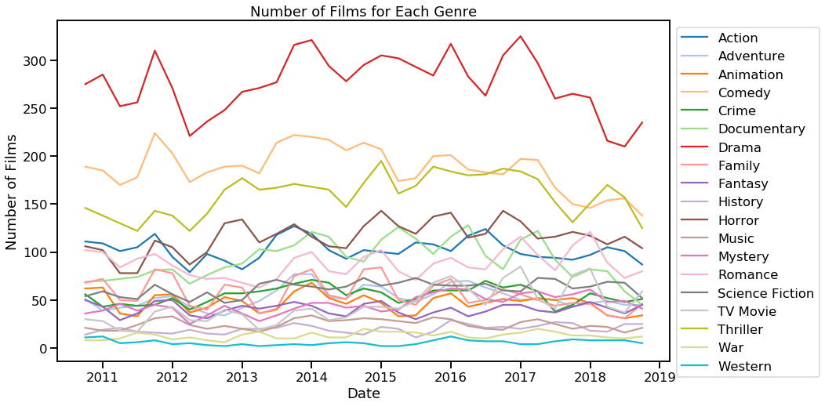
Which Films are Popular to make?
Drama
Comedy
Thriller
Horror
Documentary
Action
Romance
History
War
Western
Notes:
We’re going to take a journey through some graphs, each one with a different lesson to teach us.
As you can see, the data for 17 genres is a lot to take in.
And so, for now, needing to focus on a subset, I’ve chosen the seven most common genres.[Genres]

Slide 6
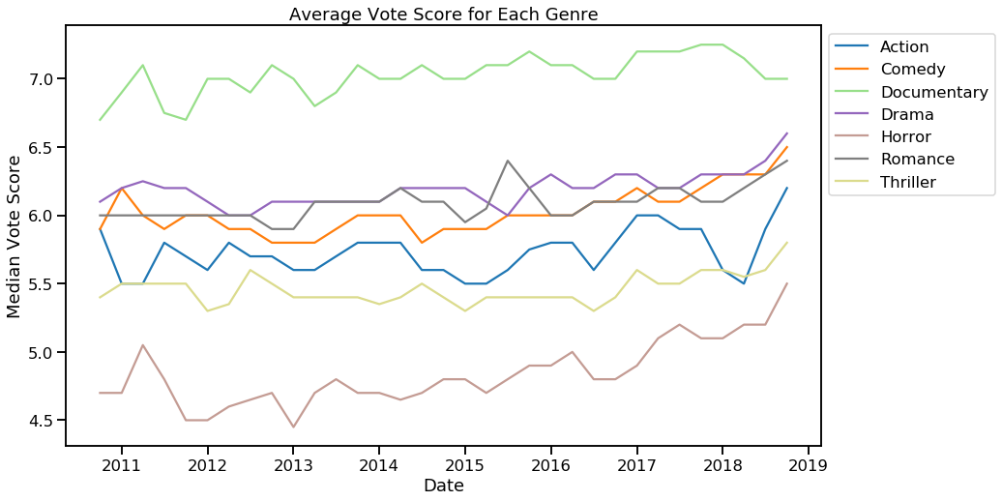
Average Vote Score
Documentaries score
consistently high
Horror rising
Notes:
Looking purely at the average vote: documentaries would seem like the way to go.
Also have to note though how Horror is showing a steady increase
But this doesn’t quite show the whole story...

Slide 7
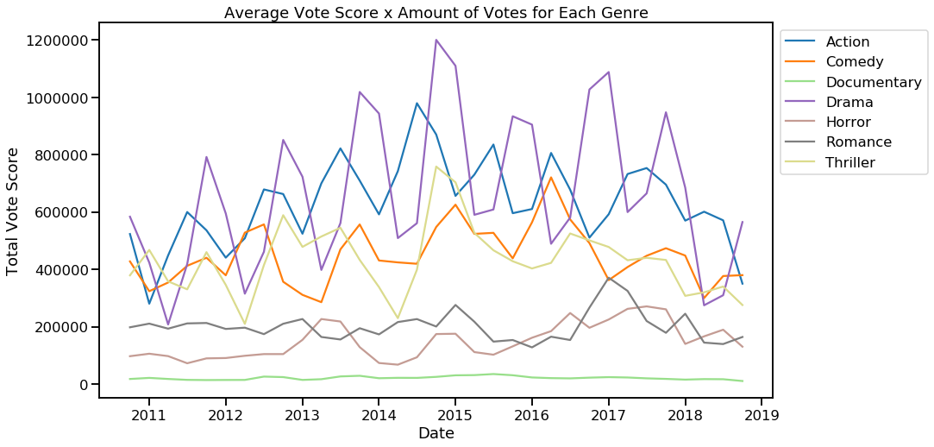
Total Vote Score
Documentary:
Low Total score
Total Vote Score =
Av. Vote x Num. Votes
Cyclic:
Best release season:
Summer: Action
Autumn: Drama
Notes:
Here we see Documentary has a low Total Vote Score
A films total vote score is its average vote score multiplied by the number of people who voted for it. And here they are summed together for each genre
This means that, although the people who like documentaries, like them a lot, they’re only for a small audience.
Another lesson from this graph is the cyclic nature of Action (in the Blue) and Drama (in the purple) show which time of the year it is best to release a film of that genre. Action: Summer; Drama: Autumn
The genre’s Total score doesn’t take the number of films into account -more films, even if unpopular, would push up the score.

Slide 8
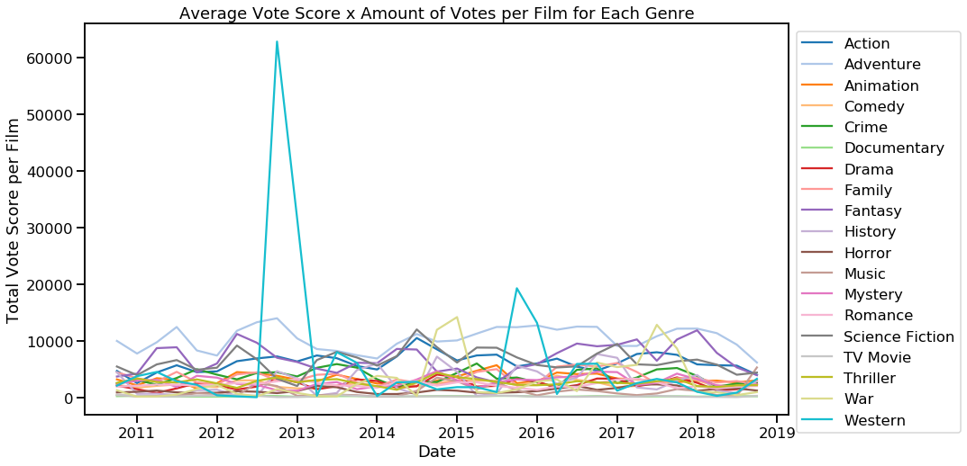
Genre Impact Total Vote Score per film
Western:
Django Unchained
The Revenant
Notes:
The genre’s Total Vote Score doesn’t take the number of films into account -more films, even if unpopular, would push up the score. So here is the TVS per film
At the start I pointed out that the genres with the fewest films made were History, war and, at the very bottom: western. However this means they are the genres where you can make the biggest impact.
As demonstrated here by Django Unchained and The revenant

Slide 9
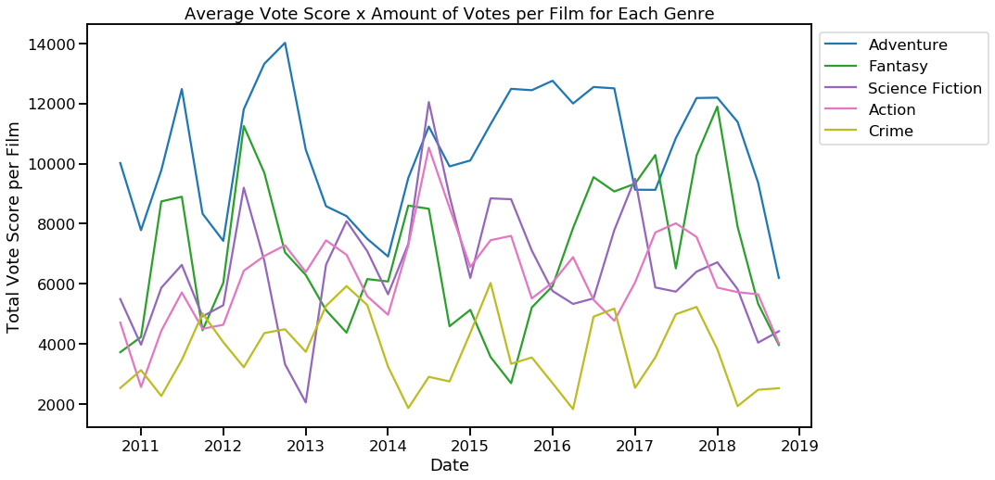
Consistent Popularity
Total Vote Score per film
-a closer look
Most consistently
popular genres:
Adventure
Fantasy
Action
Science Fiction
Crime
It is, therefore, my
recommendation to make a Fantasy-Adventure movie
Notes:
I’ve picked out the top performing genres, with somewhat more consistency than Westerns, or War

Slide 10


Slide 11
Question
How does the production budget correlate with the world wide gross and the domestic gross?

Slide 12
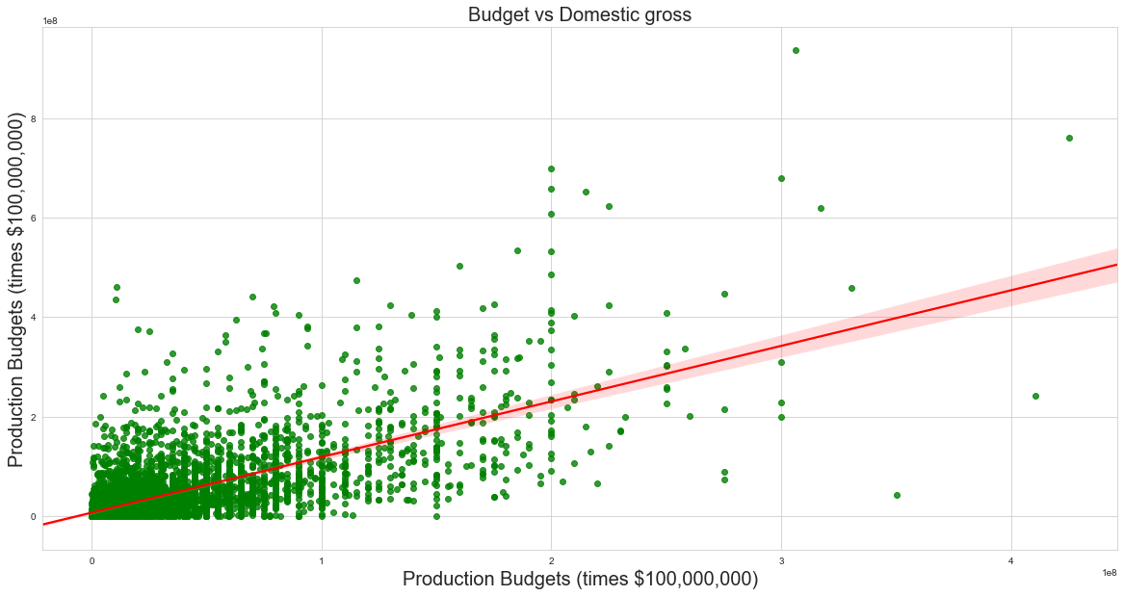
Production Budget vs Domestic Gross
The red regression line shows that there is a clear positive correlation between a larger budget and more gross income.

Slide 13
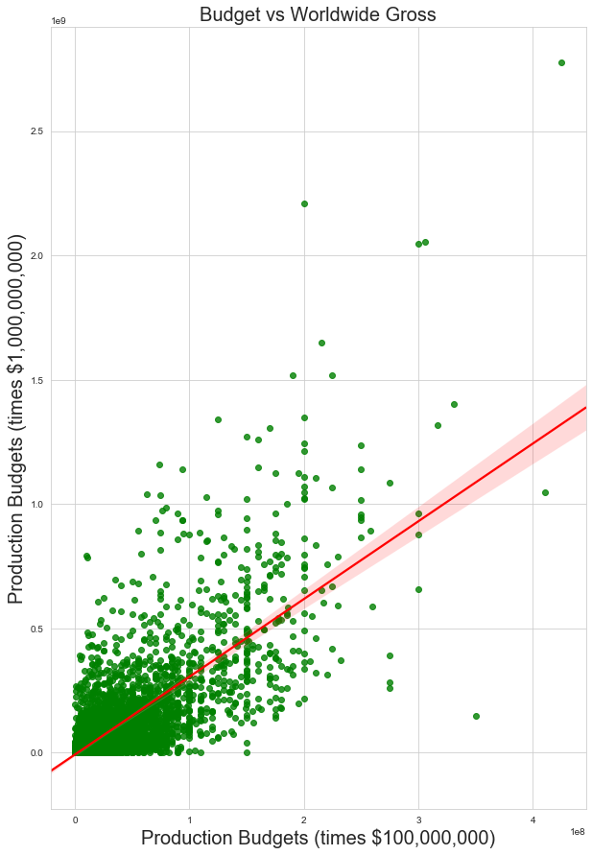
Production Budget vs Worldwide Gross
Again there is another strong correlation between the production budget and the world wide gross.
The data shows that you are better off spending more on the movie because the return on investment is better for bigger budget movies.

Slide 14
Question
Which production studio has the highest average performance?

Slide 15
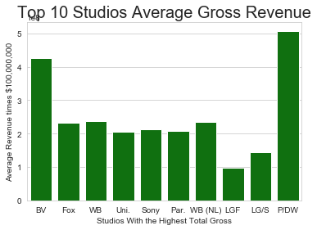
Top Ten movie studios
These are the top ten movie studios based on there total gross income. The graph shows which studios have the highest average gross income per movie. It shows that teaming up with

Slide 16
summary/conclusions
summarize all your insights in a single slide and (if applicable) add any overall recommendations

Slide 17
More time:
Dispersion of different Genre’s votes, or split it by budget: Perhaps Horror is brought down by many cheap bad horror films?

Slide 18
the “thank you” slide
possible to link to resources used, your github repo, any acknowledgements
for more professional purposes, you might link your contact info (linkedin, email, etc.)

Slide 19


